Slide 2
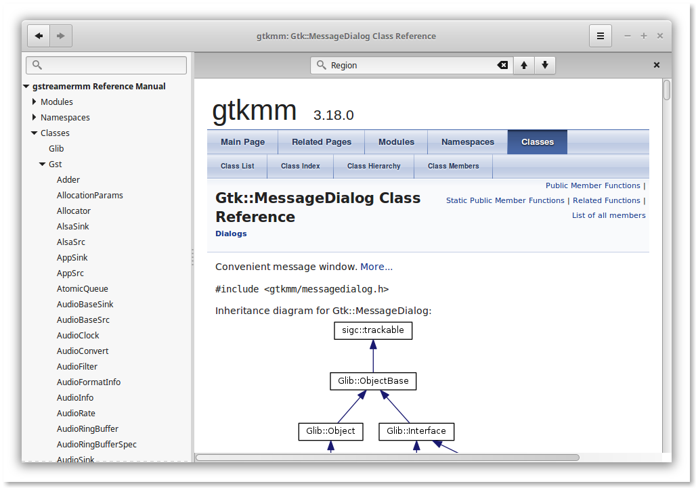
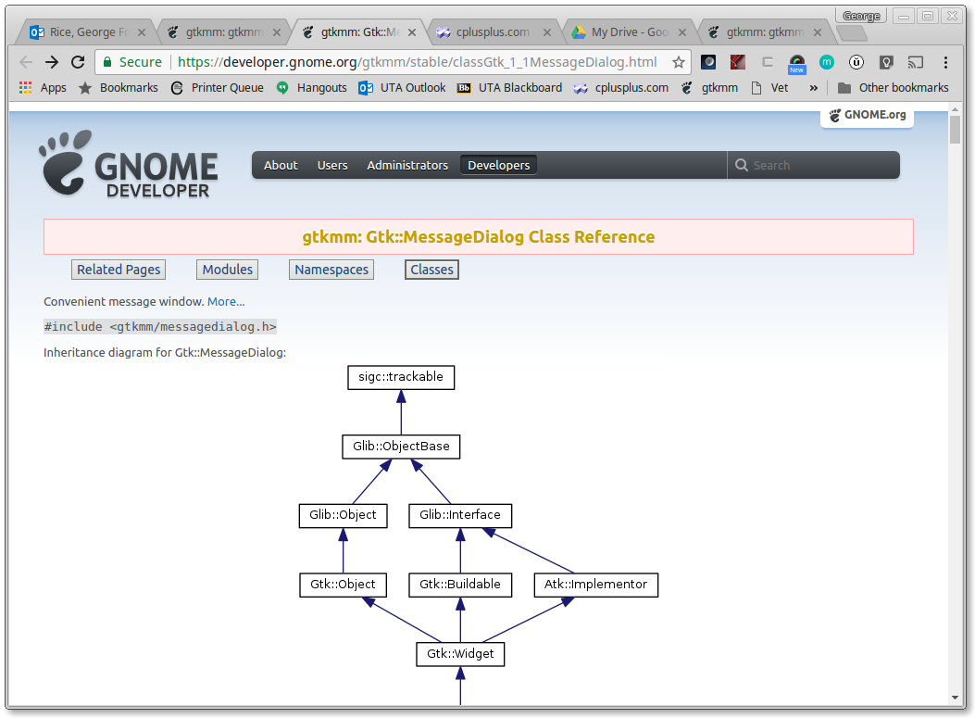
How to Learn More
About Gtk::MessageDialog
Look it up on the Gnome website
  https://developer.gnome.org/gtkmm/stable/
Use “devhelp” locally (if installed)
sudo apt-get install libgtkmm-3.0-doc
sudo apt-get install libgstreamermm-1.0-doc
sudo apt-get install devhelp

Slide 3
Interesting MessageDialog Members
MessageDialog (
const Glib::ustring& message,
bool use_markup=false,
MessageType type=MESSAGE_INFO,
ButtonsType buttons=BUTTONS_OK,
bool modal=false)
  ustring is gtkmm’s Unicode version of std::string, with full conversions to and from std::string (hint: just use “string” and all will be well)
  use_markup determines whether Pango markup is interpreted from the message (more on Pango shortly)
  type determines the icon to be presented: MESSAGE_INFO, _WARNING, _QUESTION, _ERROR, _OTHER
  buttons determines which buttons to display: BUTTONS_NONE, _OK, _CLOSE, _CANCEL, _YES_NO, or _OK_CANCEL
  modal is true if no other dialogs may take focus while this dialog is open, false otherwise (hint: This should almost ALWAYS be false!)
Note the default values enable us
to construct a MessageDialog instance
with as few as one parameter!

Slide 4
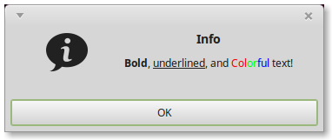
Pango Markup
Pango works similar to HTML
  The root tag is effectively <span>, which requires a </span> close and accepts attributes such as:
    font, font_size, font_style, font_weight, etc.
    fgcolor and alpha, bgcolor and bgalpha
    underline, strikethrough, and their _color variants
  Convenience tags: <b>, <big>, <i>, <s>, <sub>, <sup>, <small>, <tt> (monospace), and <u>
  "<b>Bold</b>, <u>underlined</u>,
  and <span fgcolor='#ff0000'>Col</span>
  <span fgcolor='#00ff00'>or</span>
  <span fgcolor='#0000ff'>ful</span> text!"
The Pango reference manual is at https://developer.gnome.org/pango/stable/
See test_dialogs.cpp

Slide 5
Interesting MessageDialog Members
set_secondary_text (
const Glib::ustring& text,
bool use_markup=false )
  Secondary text is positioned under the message
    In effect, the message becomes the title and the secondary text the message
  use_markup is true if the text should be processed for Pango tags
Secondary Text
Message

Slide 6
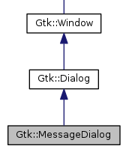
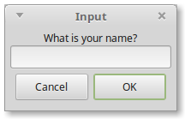
Dialog
MessageDialog is a derived case
  The base class is Dialog
  MessageDialog inherits from Dialog
Dialog is a pre-built Gtk::Window
  It provides a message (title), a Content area, a Vbox area, and a Button (action) area
  You can put any number of widgets into Content and Vbox that you like – they are “containers”
“is a”
Message (title)
Content
Vbox
Buttons (action area)
For this dialog
Label widget
Entry widget

Slide 7
Adding Buttons to a Dialog
Dialog makes special provision for this
dialog.add_button(const Glib::ustring& button_text,
int response_id)
  button_text is the text on the button, of course
  response_id is a unique integer that will be returned when a button is clicked
Dialog.set_default_response(int response_id)
  Sets the default button, which is usually activated when the user just presses Enter

Slide 8
Adding Widgets to a Dialog
Gtk::Widget *widget = new Gtk::Widget{ }
  This instances a new widget on the heap
  Replace Widget with a subclass, e.g., Entry
Configure the widget as needed
widget->show()
  This makes the widget visible on-screen
Finally, “pack” the widget into one of the containers
  dialog->get_vbox()->pack_start(*widget)
  dialog->get_content_area()->pack_start(*widget)

Slide 9
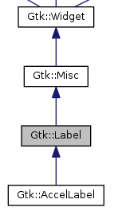
The Label Widget
Gtk::Label displays read-only text
Label (const Glib::ustring& label,
bool mnemonic=false)
  Label is the text to display
  Mnemonic can enable
  “keyboard shortcuts”, e.g., Alt-C (copy)
Label->set_use_markup(bool setting=true)
  Enables Pango (similar to HTML) in the label

Slide 10
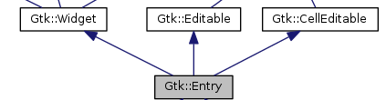
The Entry Widget
Gtk::Entry accepts a single
line of text from the user
Entry { }
  entry->set_max_length(int) sets width in chars
  entry->set_text() sets the default text for user to edit
  entry->get_text() reads the text the user entered
    The dialog returns the Response_ID of the button pushed
    Then use entry->get_text() to find out what the user typed
Pango is not supported

Slide 11
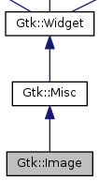
The Image Widget
Image simply displays an image
  image {const std::string& file} loads the
  image from the specified file
  Static and animated images can also be
  displayed from memory using other constructors
https://developer.gnome.org/gtkmm/stable/classGtk_1_1Image.html

Slide 12
button.signal_clicked( ).connect( sigc::mem_fun( )) ??
Yes, that’s a lot of new concepts in one line!
signal_clicked() is “emitted” when the button is activated (by, you know, clicking it)
  Also available: signal_activate(), _enter(), _leave(), _pressed(), and released()
connect() accepts a function* that can be called when signal_clicked() is emitted
sigc::mem_fun() converts an object with one of its methods into a function suitable for connect()
* Technically, a “functor”, but the distinction isn’t important yet

Slide 13
Glib::RefPtr<Gtk::Application> app =
Gtk::Application::create( ) ??
Yes, that’s a lot more gibberish. One step at a time.
Glib::RefPtr is Gtk+’s “reference-counting smart pointer”*
  We only care because Application::create creates one!**
The Gtk::Application factory handles a lot of routine aspects of setting up applications for you, saving a lot of rote typing
  GTK+ and gtkmm initialization (e.g., Gtk::Main kit(argc, argv);)
  Application uniqueness
  Session management
  Basic scriptability and desktop shell integration
  Manages a list of top-level windows for your application
* Remember unique_ptr and shared_ptr? Yep, they arrived after RefPtr. :-(
** Going forward, we’ll use “auto app = Gtk::Application::create( )” - much better!
“auto” means “this variables type is whatever type is returned by the expression”.

Slide 14
Glib::RefPtr<Gtk::Application> app =
Gtk::Application::create( ) ??
Gtk::Application::create creates a new Application instance
  The first two parameters are argc and argv, exactly as received via “int main (int argc, char *argv[ ])”
  The third parameter is the Application ID
  The last parameter is a set of flags
All parameters are optional (more or less)
  See following slides for more info
Gtk::Application::create(argc, argv, "edu.uta.cse1325.example");

Slide 15
Gtk::Application::create( ) Parameters argv and argc
Gtk apps accept standard bash arguments, such as:
  --gtk-debug options asks Gtk+ runtime to print certain debug info
    Dnd – Information about drag-and-drop
    Nogl – Turn off OpenGL, as if OpenGL support was not available
    Nograbs – Turn off all pointer and keyboard grabs
    Cursor – Information about cursor objects (only Windows)
    Draw – Information about drawing operations (only Windows)
    Eventloop – Information about event loop operation (mostly Mac)
    Xinerama – Simulate a multi-monitor setup (mostly Linux)
    Misc – Miscellaneous information
  --g-fatal-warnings causes Gtk+ to abort on the first warning, useful for catching and analyzing them in a debugger
Argv/argc may be provide to create( ) OR to run( )
https://developer.gnome.org/gtk3/stable/gtk-running.html

Slide 16
Gtk::Application::create( ) Parameters
Application ID
This enables Gtk+ to uniquely identify apps as they communicate with each other
The Application ID is a string following these rules
  IDs contain 2+ elements separated by periods ('.')
    Elements consist of letters, numbers, and underscores
    Elements may not start with a number
    Elements must contain at least one letter
  IDs may not begin with a period (‘.’)
IDs traditionally begin with your reverse domain, followed by the group, application name, and version
  edu.uta.CSE1325.example_application_id.version1
https://dbus.freedesktop.org/doc/dbus-specification.html#message-protocol-names-interface

Slide 17
Gtk::Application::create( ) Parameters
Flags
These configure certain aspects of your application’s behavior
  You won’t need any of these for homework
  You won’t see any of these on an exam
https://developer.gnome.org/glibmm/unstable/group__giommEnums.html#ga1134403b032ff66482ffece0715c69be

Slide 18
Managing Widget Memory
Consider our constructor:
‘button{"Hello, World!"}’ instances a Button, passing “Hello, World!” to the constructor
  The button object is stored as part of the Window object, and is thus deleted with the Window object
Hello::Hello() : button{"Hello, World!"} {
set_border_width(10);
button.signal_clicked().connect(
sigc::mem_fun(*this,&Hello::on_button_clicked));
add(button);
button.show();
}

Slide 19
(Mis)Managing Widget Memory
It’s common to NOT store the widget as part of the Window object, when we don’t need access later – we “create, connect, add, and forget”
This works just as well, and keeps the interface (in hello.h) cleaner
Question: When is the button above deleted?
Hello::Hello() {
set_border_width(10);
Gtk::Button *button = new Gtk::Button("Hello, World!"));
button->signal_clicked().connect(
sigc::mem_fun(*this,&Hello::on_button_clicked));
add(*button);
button->show();
}
Create
Connect
Add
Forget

Slide 20
(Mis)Managing Widget Memory
Answer: It isn’t!
  The object is independently created on the heap
  When the Window object is deleted, no references remain to the button – memory leak!
Gtk offers a solution – the “managed” widget
  Gtk will mark a Gtk widget as “managed”
  When a widget containing one or more “managed” widgets (e.g., our Window) is deleted, it will also delete all of the “managed” widgets added to it, recursively

Slide 21
Managed Widgets
We mark an instance of a Gtk widget as “managed” by passing a pointer to the widget
to the Gtk::manage function
Hello::Hello() {
set_border_width(10);
Gtk::Button *button = Gtk::manage(new Gtk::Button("Hello, World!")));
button->signal_clicked().connect(
sigc::mem_fun(*this,&Hello::on_button_clicked));
add(*button);
button->show();
}
Create
Connect
Add
Forget
Now, the Window’s destructor will “know” to delete the managed button we added!
https://developer.gnome.org/gtkmm-tutorial/stable/sec-memory-widgets.html.en#memory-managed-widgets

Slide 22
What If We Need 3 Buttons
Instead of than 1 Button?
First problem: A Window object can contain exactly 1 widget. (Seriously?)
  We need a way to add as many widgets as we like
Second problem: How will gtkmm arrange the buttons in our window?
Button 1
Button 1
Button 2
Button 3
Button 1
Button 2
Button 3
Button 2
Button 1
Button 2
?
Button 3
Button 3

Slide 23
Multi-Widget Containers
Some widgets are (invisible) “containers”
  Unlike Window, they can contain multiple widgets
  They include the ability to specify layout
Gtk::Box
Gtk::ButtonBox
“VBox”
Button 1
A single row or column of widgets, each of which may be
individually configured.
Button 1
Button 2
Button 3
Button 2
A single row or column of widgets that are configured as a group.
Button 3
Gtk::Toolbar
Gtk::Grid
An array of buttons et. al.
Button 1
Button 2
Gtk::ORIENTATION_VERTICAL
“HBox”
Button 3
Button 1
Button 2
Button 3
Grid is a 2D array of widgets, each individually configured.
Gtk::ORIENTATION_HORIZONTAL

Slide 24
Nested Containers
Container widgets may be nested to create complex dialogs and windows
Color Chooser
Available
Selected
Fuchsia
Orange
Pink
Purple
Green
Red
Yellow
>>
>
<
<<
Save
Revert
Cancel

Slide 25
Nested Containers
Container widgets may be nested to create complex dialogs and windows
Color Chooser
VBox with a Gtk::Label
and a Gtk::TreeView
(essentially a list)
Available
Fuchsia
Orange
Pink
Purple

Slide 26
Nested Containers
Container widgets may be nested to create complex dialogs and windows
Color Chooser
Vertical ButtonBox
with the top button
invisible
>>
>
<
<<

Slide 27
Nested Containers
Container widgets may be nested to create complex dialogs and windows
Color Chooser
HBox containing
a VBox, vertical
ButtonBox, and
another VBox.
Available
Selected
Fuchsia
Orange
Pink
Purple
Green
Red
Yellow
>>
>
<
<<

Slide 28
Nested Containers
Container widgets may be nested to create complex dialogs and windows
Color Chooser
Grid containing
3 buttons
Save
Revert
Cancel

Slide 29
Nested Containers
Container widgets may be nested to create complex dialogs and windows
Color Chooser
Finally, a VBox
containing the
HBox and Grid
Available
Selected
And the VBox is the ONLY widget in the Window!
The reason Window can contain only 1 widget is because we can’t know in advance how to lay out multiple widgets in Window. YOU decide – by selecting the container widget to add to the Window!
Fuchsia
Orange
Pink
Purple
Green
Red
Yellow
>>
>
<
<<
Save
Revert
Cancel

Slide 30
Creating a Menu Bar
We* can now create arbitrarily complex widget arrangements
  Boxes and Grids of widgets
  Tool Bars via Toolbar
All we need now is a Menu Bar
  Step by step procedure follows
My Application
File Edit View Insert Format Window Help
New..
Open...
Save
Save As...
Close
Exit
* Well, given a little practice, you can! 😊

Slide 31
Creating a Menu Bar
First, add a vertical Box to the Window
  This will allow us to add (top to bottom) a menu bar, a tool bar, and a container for our content
My Application
Menu Bar goes here
Tool Bar goes here
Content goes here
Step 0: Add a VBox to the Window
https://developer.gnome.org/gtkmm/stable/classGtk_1_1Box.html

Slide 32
Creating a Menu Bar
Second, instance a Gtk::MenuBar and add it to the vertical Gtk::Box instance in the Window
  Its append method will enable you to add drop-down menu items such as File, Edit, View, ...
My Application
Step 1: Add MenuBar to the VBox
Step 0: Add a VBox to the Window
https://developer.gnome.org/gtkmm/stable/classGtk_1_1MenuBar.html

Slide 33
Creating a Menu Bar
Instance a Gtk::MenuItem, e.g., for File, and append it to the Gtk::MenuBar instance
  Do this for each additional top-level menu,
  e.g., Edit, View, …, Help
Step 2: Add MenuItem
to MenuBar
My Application
File Edit View Insert Format Window Help
Step 1: Add MenuBar to the VBox
Step 0: Add a VBox to the Window
https://developer.gnome.org/gtkmm/stable/classGtk_1_1MenuItem.html

Slide 34
Creating a Menu Bar
For each top-level menu item, instance Gtk::Menu, which is the “drop down” functionality
  Add using Gtk::MenuItem’s set_submenu method
https://developer.gnome.org/gtkmm/stable/classGtk_1_1Menu.html
Step 2: Add MenuItem
to MenuBar
My Application
File Edit View Insert Format Window Help
Step 1: Add MenuBar to the VBox
Step 3: Add Menu
to MenuItem
Step 0: Add a VBox to the Window

Slide 35
Creating a Menu Bar
To populate the drop-down menu, instance more Gtk::MenuItem objects
  Add to the Gtk::Menu instance using its append method
Step 2: Add MenuItem
to MenuBar
My Application
File Edit View Insert Format Window Help
New..
Open...
Save
Save As...
Close
Exit
Step 1: Add MenuBar to the VBox
Step 3: Add Menu
to MenuItem
Step 0: Add a VBox to the Window
Step 4: Add MenuItem
to Menu

Slide 36
Creating a Menu Bar
Finally, connect your handler methods for each menu item to the associated Gtk::MenuItem instance
  The same handler can service both menu items and tool bar buttons
Step 2: Add MenuItem
to MenuBar
My Application
File Edit View Insert Format Window Help
New..
Open...
Save
Save As...
Close
Exit
Step 1: Add MenuBar to the VBox
Step 3: Add Menu
to MenuItem
Step 0: Add a VBox to the Window
Step 4: Add MenuItem
to Menu
Step 5: Connect signal_activate to handler(s)
for MenuItem

Slide 37
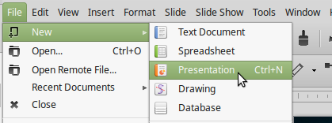
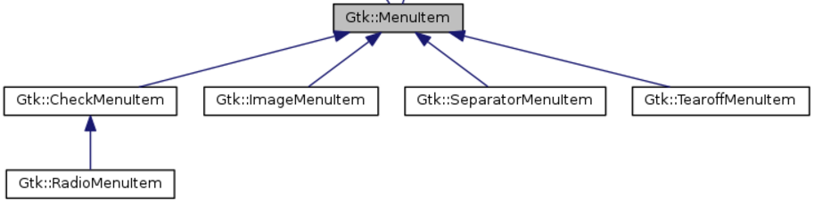
Fancier Gtk::MenuItem Methods
Menu items can change in response to events
  Additional levels can be added via set_submenu
    Same as above
  Attributes can change
    set_label to change text
    set_visible to show or hide
    set_sensitive to enable or disable (grey) response to click
    set_tooltip_text sets tool tip displayed on mouse hover
MenuItem also has some specialized derived classes

Slide 38







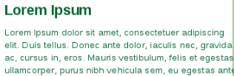
Putting It All Together
We can now create a “main window”
  Menu bar and tool bar
  Boxes and Grids of widgets
  Content
Let’s review code for simple C++ GUI application
My Application
File Edit View Insert Format Window Help
+
Space Shuttle Discovery image is public domain per https://www.nasa.gov/multimedia/guidelines/index.html
Icons adapted from Umar Irshad’s “Bubbles” icon set, https://iconfinder.com, “Free for Commercial Use”

Slide 39
The Game of Nim
A set of sticks is piled between the 2 players
  Each player in turn takes 1, 2, or 3 sticks
  The player who draws the last stick loses
We’ll write this game for 1 or 2 human players
Buttons
New Game
Take Sticks
Enable Computer Player
Exit
File
Help
The Game of Nim
New game..
Exit
About...
File Help
+
1
2
3
X
| | | | | | | | | | | | | | | (15 sticks)
1
Moves that are unavailable (e.g., fewer than 3 sticks remain) will be insensitive with buttons “greyed out”.
2
Player 1’s turn
3
Icons adapted from Umar Irshad’s “Bubbles” icon set, https://iconfinder.com, “Free for Commercial Use”

Slide 40
Let’s Review One Possible gtkmm Implementation of Nim
IMPORTANT: This app was developed in “baby steps”, using git, ddd, and test code, as usual
  Here we’re reviewing code only, as one way that gtkmm can be used to implement a classic GUI interface
  We’ll review the process in lectures 16 & 17
We’ll look at a “code-centric” GUI implementation, though others exist, e.g.,
  Use GLADE to drag-and-drop the interface design, save as an XML file, and use Gtk::Builder to load and show
  Use helper libraries that pre-select sane defaults
  to reduce the amount of code we have to write

Slide 41
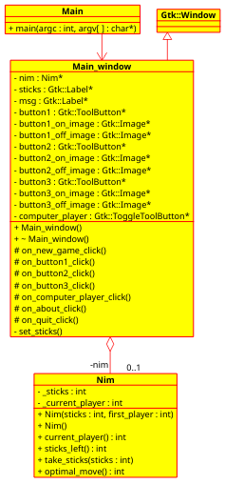
Nim Interface
An instance of this class manages one game
  To create a new game,
  instance Nim again
#ifndef _NIM_H_
#define _NIM_H_
class Nim {
public:
Nim(int sticks, int first_player = 1);
Nim(); // All options randomized
int current_player(); // Player to move next
int sticks_left(); // Number of sticks in pile
void take_sticks(int sticks); // Remove sticks from pile
int optimal_move(); // Best move to win
private:
int _sticks; // Number of sticks in pile
int _current_player; // Player to move next
};
#endif
nim.h

Slide 42
Nim Implementation
(The “Model” - Irrelevant to the GUI, of course)
#include "nim.h"
#include <stdexcept>
#include <cstdlib>
Nim::Nim(int sticks, int first_player)
: _sticks{sticks}, _current_player{first_player} {
}
Nim::Nim() {
srand (time(NULL));
_sticks = std::rand() % 9 + 7;
_current_player = std::rand() % 2 + 1;
}
int Nim::current_player() {
return _current_player;
}
int Nim::sticks_left() {
return _sticks;
}
void Nim::take_sticks(int sticks) {
if (_sticks >= sticks) _sticks -= sticks;
else throw std::runtime_error("Out of sticks!");
if (_sticks > 0) _current_player = 3 - _current_player;
}
nim.cpp
int Nim::optimal_move() {
if (_sticks <= 1) return 1;
switch(_sticks%4) {
case 0: return 3;
case 1: return std::rand()%3+1;
case 2: return 1;
case 3: return 2;
default: throw std::runtime_error
("Internal calculation error!");
}
}

Slide 43
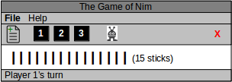
Main Window Interface
(Page 1 of 2)
#ifndef MAIN_WINDOW_H
#define MAIN_WINDOW_H
#include <gtkmm.h>
#include "nim.h"
class Main_window : public Gtk::Window {
public:
Main_window();
virtual ~Main_window();
protected:
void on_new_game_click(); // Create a new game
void on_button1_click(); // Select one stick from pile
void on_button2_click(); // Select two sticks from pile
void on_button3_click(); // Select three sticks from pile
void on_computer_player_click(); // Enable / disable computer player
void on_about_click(); // Display About dialog
void on_quit_click(); // Exit the game
private:
void set_sticks(); // Update display, robot move
Nim *nim;
main_window.h
Constructor and Destructor
Callbacks (from gtkmm widgets)
Utility and pointer to game instance
(Continued on next slide)

Slide 44
Main Window Interface
(Page 2 of 2)
Gtk::Label *sticks; // Display of sticks on game board
Gtk::Label *msg; // Status message display
Gtk::ToolButton *button1; // Button to select 1 stick
Gtk::Image *button1_on_image; // Image when active
Gtk::Image *button1_off_image; // Image when inactive
Gtk::ToolButton *button2; // Button to select 2 sticks
Gtk::Image *button2_on_image;
Gtk::Image *button2_off_image;
Gtk::ToolButton *button3; // Button to select 3 sticks
Gtk::Image *button3_on_image;
Gtk::Image *button3_off_image;
Gtk::ToggleToolButton *computer_player; // Button to enable robot
};
#endif
main_window.h
GUI widgets
Notes:
You only need to retain pointers to widgets that you plan to modify in callbacks.
gtkmm retains references to all widgets that you add to containers.
If the window closes, all Gtk-managed widgets will be deleted automatically.
If you try to dereference them later via these pointers, you’ll likely cause a segfault!

Slide 45
Main_window Constructor
Implementation Outline
Add a VBox to the Window (from which Main_window is derived)
Add the menu at the top of the vbox
  Add a File drop-down menu
    Add New Game to the File menu
    Add Quit to the File menu
  Add a Help drop-down menu
    Add About to the Help menu
Add the toolbar just below the menu
  Add a New Game button
  Add 1 stick, 2 stick, and 3 stick buttons
  Add a 2-state Computer Player button – when down, computer is Player 2
  Add a Quit button aligned to the right of the toolbar
Add the Sticks display below the toolbar, which resizes with the window
Add the Status Bar display at the bottom

Slide 46
Main_window Constructor
(Page 1 of 7)
main_window.cpp
Here’s the code (in 7 slides)
to implement that outline
Main_window::Main_window() {
// /////////////////
// G U I S E T U P
// /////////////////
set_default_size(400, 200);
// Put a vertical box container as the Window contents
Gtk::Box *vbox = Gtk::manage(new Gtk::Box(Gtk::ORIENTATION_VERTICAL, 0));
add(*vbox);
// ///////
// M E N U
// Add a menu bar as the top item in the vertical box
Gtk::MenuBar *menubar = Gtk::manage(new Gtk::MenuBar());
vbox->pack_start(*menubar, Gtk::PACK_SHRINK, 0);

Slide 47

Main_window Constructor
(Page 2 of 7)
main_window.cpp
// F I L E
// Create a File menu and add to the menu bar
Gtk::MenuItem *menuitem_file = Gtk::manage(new Gtk::MenuItem("_File", true));
menubar->append(*menuitem_file);
Gtk::Menu *filemenu = Gtk::manage(new Gtk::Menu());
menuitem_file->set_submenu(*filemenu);
// N E W G A M E
// Append New to the File menu
Gtk::MenuItem *menuitem_new = Gtk::manage(new Gtk::MenuItem("_New Game", true));
menuitem_new->signal_activate().connect(sigc::mem_fun(*this,
&Main_window::on_new_game_click));
filemenu->append(*menuitem_new);
// Q U I T
// Append Quit to the File menu
Gtk::MenuItem *menuitem_quit = Gtk::manage(new Gtk::MenuItem("_Quit", true));
menuitem_quit->signal_activate().connect(sigc::mem_fun(*this,
&Main_window::on_quit_click));
filemenu->append(*menuitem_quit);

Slide 48
Main_window Constructor
(Page 3 of 7)
main_window.cpp
// H E L P
// Create a Help menu and add to the menu bar
Gtk::MenuItem *menuitem_help = Gtk::manage(new Gtk::MenuItem("_Help", true));
menubar->append(*menuitem_help);
Gtk::Menu *helpmenu = Gtk::manage(new Gtk::Menu());
menuitem_help->set_submenu(*helpmenu);
// A B O U T
// Append About to the Help menu
Gtk::MenuItem *menuitem_about = Gtk::manage(new Gtk::MenuItem("About", true));
menuitem_about->signal_activate().connect(sigc::mem_fun(*this,
&Main_window::on_about_click));
helpmenu->append(*menuitem_about);

Slide 49
Main_window Constructor
(Page 4 of 7)
main_window.cpp
// /////////////
// T O O L B A R
// Add a toolbar to the vertical box, right below the menu
Gtk::Toolbar *toolbar = Gtk::manage(new Gtk::Toolbar);
vbox->add(*toolbar);
// N E W G A M E
// Add a “new game” button
Gtk::ToolButton *new_game_button = Gtk::manage
(new Gtk::ToolButton(Gtk::Stock::NEW)); // Use the default NEW icon
new_game_button->set_tooltip_markup
("Create a new name, discarding any in progress"); // Add a tooltip
new_game_button->signal_clicked().connect(sigc::mem_fun
(*this, &Main_window::on_new_game_click)); // Call this when clicked
toolbar->append(*new_game_button);

Slide 50
Main_window Constructor
(Page 5 of 7)
main_window.cpp
// O N E S T I C K
// Add a icon for taking one stick
button1_on_image = Gtk::manage(new Gtk::Image{"button1_on.png"}); // Load icon
button1_off_image = Gtk::manage(new Gtk::Image{"button1_off.png"}); // images
button1 = Gtk::manage(new Gtk::ToolButton{*button1_on_image}); // Create button
button1->set_tooltip_markup("Select one stick"); // with image
button1->signal_clicked().connect(sigc::mem_fun(*this,
&Main_window::on_button1_click));
toolbar->append(*button1);
// T W O S T I C K S
// Add a icon for taking two sticks
button2_on_image = Gtk::manage(new Gtk::Image{"button2_on.png"});
button2_off_image = Gtk::manage(new Gtk::Image{"button2_off.png"});
button2 = Gtk::manage(new Gtk::ToolButton{*button2_on_image});
button2->set_tooltip_markup("Select two sticks");
button2->signal_clicked().connect(sigc::mem_fun(*this,
&Main_window::on_button2_click));
toolbar->append(*button2);
// T H R E E S T I C K S (Analogous to the above code)

Slide 51
Main_window Constructor
(Page 6 of 7)
Note: A ToggleButton retains state, alternating
between “up” and “down” on each click. It’s
current state is read using its get_active method.
main_window.cpp
// C O M P U T E R P L A Y E R
// Add a toggle button to enable computer to play as Player 2
Gtk::Image *robot_image = Gtk::manage(new Gtk::Image{"freepik_robot.png"});
computer_player = Gtk::manage(new Gtk::ToggleToolButton{*robot_image});
computer_player->set_tooltip_markup("Enable for computer to be Player 2");
computer_player->signal_clicked().connect(sigc::mem_fun(*this,
&Main_window::on_computer_player_click));
Gtk::SeparatorToolItem *sep1 = Gtk::manage(new Gtk::SeparatorToolItem{});
toolbar->append(*sep1); // Add a little space between this and the stick buttons
toolbar->append(*computer_player);
// Q U I T
// Add a icon for quitting
Gtk::ToolButton *quit_button = Gtk::manage(new Gtk::ToolButton{Gtk::Stock::QUIT});
quit_button->set_tooltip_markup("Exit game");
quit_button->signal_clicked().connect(sigc::mem_fun(*this,
&Main_window::on_quit_click));
Gtk::SeparatorToolItem *sep = Gtk::manage(new Gtk::SeparatorToolItem{});
sep->set_expand(true); // The expanding sep forces the Quit button to the right
toolbar->append(*sep);
toolbar->append(*quit_button);

Slide 52
Main_window Constructor
(Page 7 of 7)
main_window.cpp
// S T I C K S D I S P L A Y
// Provide a text entry box to show the remaining sticks
sticks = Gtk::manage(new Gtk::Label{});
sticks->set_hexpand(true); // Fill to the right of the window
sticks->set_vexpand(true); // Fill any extra vertical space (as the window resizes)
vbox->add(*sticks);
// S T A T U S B A R D I S P L A Y
// Provide a status bar for game messages
msg = Gtk::manage(new Gtk::Label{});
msg->set_hexpand(true);
vbox->add(*msg);
// Make the box and everything in it visible
vbox->show_all();
// Start a new game
on_new_game_click();
}

Slide 53
Main_window Callbacks
(Page 1 of 2)
main_window.cpp
// /////////////////
// C A L L B A C K S
// /////////////////
void Main_window::on_button1_click() {
nim->take_sticks(1);
set_sticks();
}
void Main_window::on_button2_click() {
nim->take_sticks(2);
set_sticks();
}
void Main_window::on_button3_click() {
nim->take_sticks(3);
set_sticks();
}

Slide 54
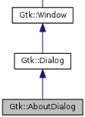
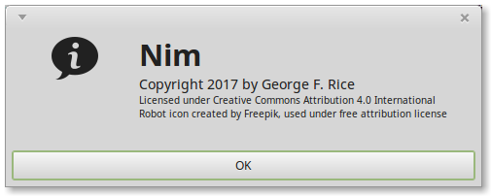
Main_window Callbacks
(Page 2 of 2)
Hint: Use Gtk::AboutDialog
instead of MessageDialog
in real applications!
main_window.cpp
void Main_window::on_computer_player_click() {
set_sticks();
}
void Main_window::on_new_game_click() {
nim = new Nim();
set_sticks();
}
void Main_window::on_quit_click() {
hide();
}
void Main_window::on_about_click() {
Glib::ustring s = "<span size='24000' weight='bold'>Nim</span>\n<span size='large'>Copyright 2017 by George F. Rice</span>\n<span size='small'>Licensed under Creative Commons Attribution 4.0 International\nRobot icon created by Freepik, used under free attribution license</span>";
Gtk::MessageDialog dlg(*this, s, true, Gtk::MESSAGE_INFO, Gtk::BUTTONS_OK, true);
dlg.run();
}
The Pango formatting below produces this
(after a little trial and error!)

Slide 55
Main_window Utilities
(Page 1 of 2)
// /////////////////
// U T I L I T I E S
// /////////////////
void Main_window::set_sticks() {
// s collects the status message
Glib::ustring s = "";
// If the robot is enabled and it's their turn, move the robot
if (nim->sticks_left() > 0) {
if (computer_player->get_active() && nim->current_player() == 2) {
s += "Robot plays " + std::to_string(nim->optimal_move()) + ", ";
nim->take_sticks(nim->optimal_move());
}
}
// Report who's turn it is, or (if all of the sticks are gone) who won
if (nim->sticks_left() > 0) {
s += "Player " + std::to_string(nim->current_player()) + "'s turn";
} else {
s += "<span size='16000' weight='bold'>Player "
+ std::to_string(3-nim->current_player())
+ " wins!</span>";
}
main_window.cpp
(Continued on next slide)

Slide 56
Main_window Utilities
(Page 2 of 2)
// Display the collected status on the status bar
msg->set_markup(s);
// Update the visual display of sticks
s = "<span size='24000' weight='bold'>";
for(int i=0; i<nim->sticks_left(); ++i) s.append("| ");
s.append("</span> (" + std::to_string(nim->sticks_left()) + " sticks)");
sticks->set_markup(s);
// Set sensitivity of the human stick selectors so user can't make an illegal move
button1->set_sensitive(nim->sticks_left() > 0);
button2->set_sensitive(nim->sticks_left() > 1);
button3->set_sensitive(nim->sticks_left() > 2);
}
main_window.cpp

Slide 57
Main
#include "main_window.h"
#include <gtkmm.h>
int main (int argc, char *argv[])
{
auto app = Gtk::Application::create(argc, argv, "edu.uta.cse1325.nim");
// Instance a Window
Main_window win;
// Set the window title
win.set_title("Nim");
//Show the window and returns when it is closed or hidden
return app->run(win);
}
main.cpp

Slide 58
Nim Makefile
CXXFLAGS = --std=c++14
GTKFLAGS = `/usr/bin/pkg-config gtkmm-3.0 --cflags --libs`
all: main_window
debug: CXXFLAGS += -g
debug: main_window
main_window: main.o main_window.o nim.o
$(CXX) $(CXXFLAGS) -o nim main.o main_window.o nim.o $(GTKFLAGS)
main.o: main.cpp main_window.h
$(CXX) $(CXXFLAGS) -c main.cpp $(GTKFLAGS)
main_window.o: main_window.cpp main_window.h
$(CXX) $(CXXFLAGS) -c main_window.cpp $(GTKFLAGS)
nim.o: nim.cpp nim.h
$(CXX) $(CXXFLAGS) -c nim.cpp
clean:
-rm -f *.o *.gch *~ nim
Makefile

Slide 59
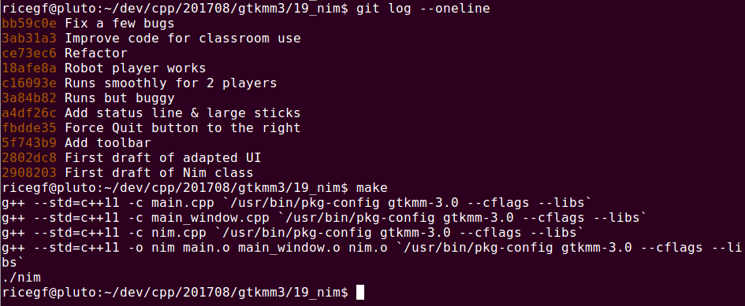
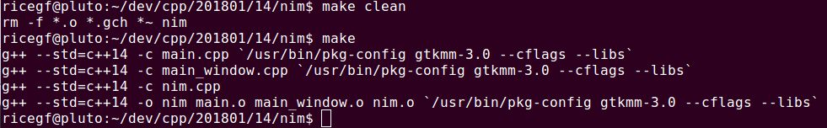
git Log and Make

Slide 60
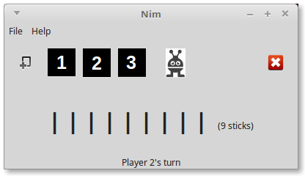
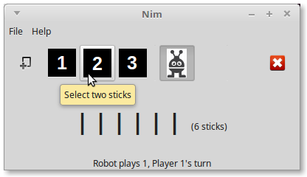
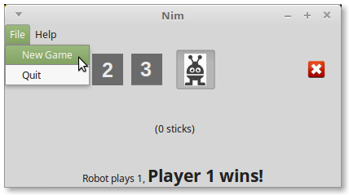
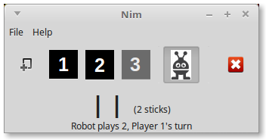
Interactively Testing Nim
Two-player mode
One-player mode
Resizing the window
Detecting a win

